Slide 1
Measuring Reliability: The Intraclass Correlation Coefficient
Lee Friedman, Ph.D.

Slide 2
What is Reliability? Validity?
Reliability is the CONSISTENCY with which a measure assesses a given trait.
Validity is the extent to which a measure actually measures a trait.
The issue of reliability surfaces when 2 or more raters have all rated N subjects on variable that is either
d ichotomous
nominal
ordinal
interval
ratio scale

Slide 3
How does this all relate to Multicenter fMRI Research?
If one thinks of MRI scanners as Raters the parallel becomes obvious.
We want to know if the different MRI scanners measure activation in the same subjects CONSISTENTLY.
Without such consistency multicenter fMRI research will not make much sense.
Therefore we need to know what the reliability among scanners (as raters) is.
Perhaps we need to think of MRI-centers, not MRI scanners as raters.

Slide 4
What are the main measures of reliability?
What if the data are dichotomous or polychotomous?
Reliability should be assessed with some type of Kappa coefficient
What if the data are quantitative (interval or ratio scale?
Reliability should be measured with the Intraclass Correlation Coefficient (ICC)
The various types of ICC and their use is what we will talk about here.

Slide 5
Interclass vs Intraclass Correlation Coefficients: What is a class?
What is a class of variables? Variables that share a:
metric (scale), and
variance
Height and Weight are different classes of variables.
There is only 1 Interclass correlation coefficient – Pearson’s r.
When one is interested in the relationship between variables of a common class, one uses an Intraclass Correlation Coefficient.

Slide 6
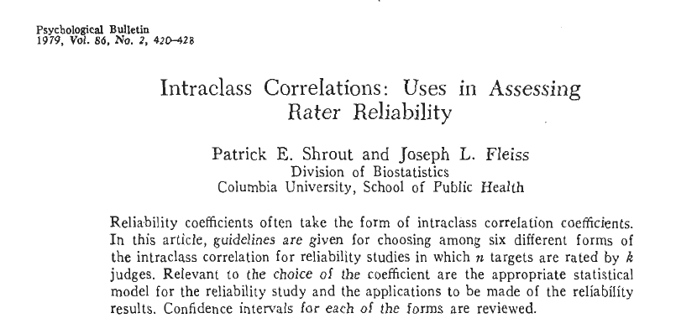

Slide 7
Big Picture: What is the Intraclass Correlation Coefficient?
It is, as a general matter, the ratio of two variances:
Variance due to rated subjects (patients)
ICC = --------------------------------------------------------------------
(Variance due to subjects + Variance due to Judges + Residual Variance)

Slide 8
Shrout and Fleiss, 1979
A seminal paper
Psychological Bulletin 1979 86:420-428
Propose 6 ICC types:
ICC(1,1)
ICC(2,1)
ICC(3,1)
ICC(1,n)
ICC(2,n)
ICC(3,n)
As a general rule, for the vast majority of applications, only 1 of S&F’s ICCs [ICC(2,1)] is needed.
}
Expected Reliability of a Single Rater’s Rating
}
Expected Reliability of the Mean of a set of
n Raters

Slide 9
A Typical Case:
4 nurses rate 6 patients on a 10 point scale
Patients | Rater1 | Rater2 | Rater3 | Rater4
1 | 9 | 2 | 5 | 8
2 | 6 | 1 | 3 | 2
3 | 8 | 4 | 6 | 8
4 | 7 | 1 | 2 | 6
5 | 10 | 5 | 6 | 9
6 | 6 | 2 | 4 | 7
When we have k patients chosen at random, and they are rated by n raters, and we want to be sure that AGREE (i.e., are INTERCHANGEABLE) on the ratings, then there is only one Shrout and Fleiss ICC, ICC(2,1). This is also know as an ICC(AGREEMENT).

Slide 10
4 nurses rate 6 patients on a 10 point scale
Patients | Rater1 | Rater2 | Rater3 | Rater4
1 | 2 | 3 | 4 | 5
2 | 3 | 4 | 5 | 6
3 | 4 | 5 | 6 | 7
4 | 5 | 6 | 7 | 8
5 | 6 | 7 | 8 | 9
6 | 7 | 8 | 9 | 10
When we have k patients chosen at random, and they are rated by n raters, and we don’t object if there are additive offsets as long as the raters are consistent, then we are interested in ICC(3,1). This is also known as an ICC(CONSISTENCY). I think this is a pretty unlikely situation for us, especially if we want to merge data from multiple sites.

Slide 11
6 patients are rated 4 times by 4 of 100 possible MRI Centers
Patients
1 | Chicago | Los Angles | San Fran | Miami
2 | Boston | Atlanta | Montreal | Minneapolis
3 | Seattle | Pittsburg | New Orleans | Houston
4 | Tucson | Albuquerque | Philadelphia | Dallas
5 | Burlington | New York | Portland | Cleveland
6 | Palo Alto | Iowa City | San Diego | Phoenix
When we have k patients chosen at random, and they are rated by a random set of raters, and there is no requirement that the same rater rate all the subjects, then we have a completely random one way design. Reliability is assessed with a ICC(1,1).

Slide 12
What about ICCs for the Mean of a Set of Raters?
ICC(1,n), ICC(2,n) and ICC(3,n) are ICCs for the mean of the raters.
This would apply if the ultimate goal was to rate every patient by a team of raters and take the final rating to be the mean of the set of raters.
In my experience this never is the goal. The goal is always to prove that each rater, taken as an individual, is reliable and can be used to subsequently rate patients on their own.
Use of these ICC’s is usually the result of low single rater reliability.

Slide 13
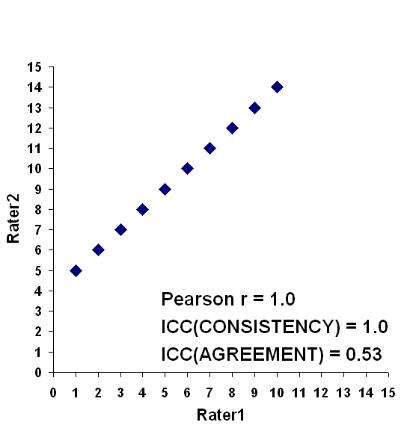
Example 1: Rater 2 always rates 4 points higher than Rater 1

Slide 14
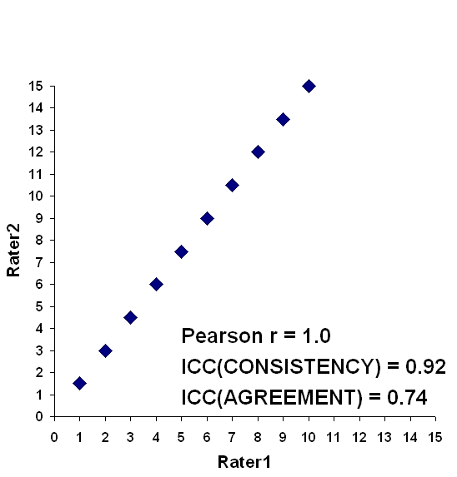
Example 2: Rater 2 always rates 1.5 * Rater 1

Slide 15
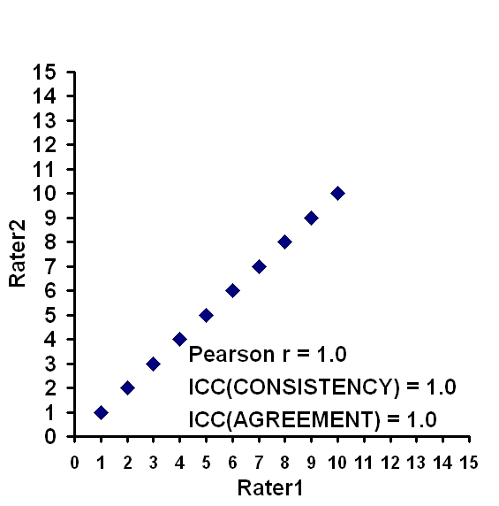
Example 3: Rater 2 always rates the same as Rater 1

Slide 16
So, Once Again….
In the S&F nomenclature, there is only 1 ICC that measures the extent of absolute AGREEMENT or INTERCHANGEABILITY of the raters, and that is ICC(2,1) which is based on the two-way random-effects ANOVA.
This is the ICC we want.

Slide 17
McGraw and Wong vs S&F Nomenclature
SPSS provides easy to use tools to measure the S&F ICCs, but the nomenclature employed by SPSS is based on McGraw and Wong (1996), Psychological Methods 1:30-46., not S&F.

Slide 18
Relationship between SPSS Nomenclature and S&F Nomenclature
For SPSS, you must choose:
(1) An ANOVA Model
(2) A Type of ICC
ANOVA Model | ICC(1,1)
One way Random Effects
TYPE: | Consistency | Absolute Agreement
Two way Random Effects |  | ICC(2,1) “ICC(AGREEMENT)”
Two way Mixed Model : Raters Fixed Patients Random | ICC(3,1) “ICC(CONSISTENCY)”

Slide 19
Is Your ICC Statistically Significant?
If the question is:
Is your ICC statistically significantly different from 0.0? then the F test for the patient effect (the row effect) will give you your answer. SPSS provides this.
If the question is:
Is your ICC statistically significantly different from some other value, say 0.6? then confidence limits around the ICC estimate are provided by S&F, M&W and SPSS. In addition, significance tests are provided by M&W and SPSS.

Slide 20
ICC(AGREEMENT) is what we typically want.
How to measure it the easy way using SPSS.
Start with sample data presented in S&F (1979).

Slide 21
Example 1: Depression Ratings
4 nurses rate 6 patients on a 10 point scale
Patients | Nurse1 | Nurse2 | Nurse3 | Nurse4
1 | 9 | 2 | 5 | 8
2 | 6 | 1 | 3 | 2
3 | 8 | 4 | 6 | 8
4 | 7 | 1 | 2 | 6
5 | 10 | 5 | 6 | 9
6 | 6 | 2 | 4 | 7

Slide 22
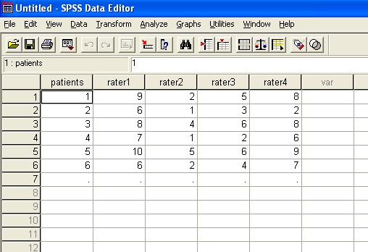
Enter data into SPSS

Slide 23
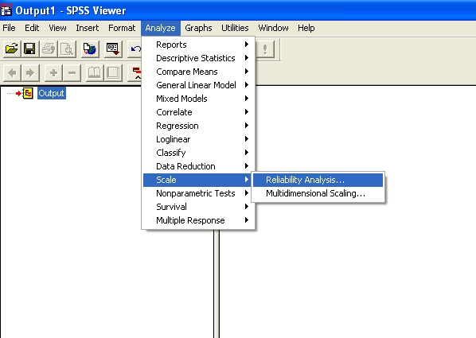
Find the Reliability Analysis

Slide 24
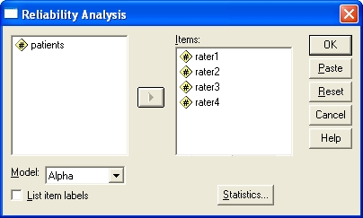
Select Raters

Slide 25
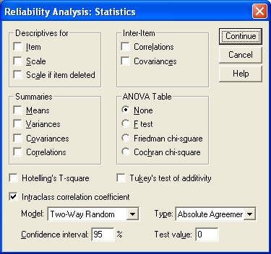
Choose Analysis

Slide 26
Slide Title
R E L I A B I L I T Y A N A L Y S I S
Intraclass Correlation Coefficient
Two-way Random Effect Model (Absolute Agreement Definition):
People and Measure Effect Random
Single Measure Intraclass Correlation = .2898*
95.00% C.I.: Lower = .0188 Upper = .7611
F = 11.02 DF = (5,15.0) Sig. = .0001 (Test Value = .00)
Average Measure Intraclass Correlation = .6201
95.00% C.I.: Lower = .0394 Upper = .9286
F = 11.0272 DF = (5,15.0) Sig. = .0001 (Test Value = .00)
Reliability Coefficients
N of Cases = 6.0 N of Items = 4

Slide 27
A KEY POINT!!!! VARIABILITY IN THE PATIENTS (SUBJECTS)
WHEN YOU DESIGN A RELIABILITY STUDY, YOU MUST ATTEMPT TO HAVE THE VARIABILITY AMONG PATIENTS (OR SUBJECTS) MATCH THE VARIABILITY OF THE PATIENTS TO BE RATED IN THE SUBSTANTIVE STUDY.
IF THE VARIABILITY OF THE SUBJECTS IN THE RELIABILITY STUDY IS SUBSTANTIALLY LESS THAN THAT OF THE SUBSTANTIVE STUDY, YOU WILL UNDERESTIMATE THE RELEVANT RELIABILITY.
IF THE VARIABILITY OF THE SUBJECTS IN THE RELIABILITY STUDY IS SUBSTANTIALLY GREATER THAN THAT OF THE SUBSTANTIVE STUDY, YOU WILL OVERESTIMATE THE RELEVANT RELIABILITY

Slide 28

Sample Size for Reliability Studies
There are methods for determining sample size for ICC-based reliability studies, based on a power, predicted ICC and a lower confidence limit. See:

Slide 29
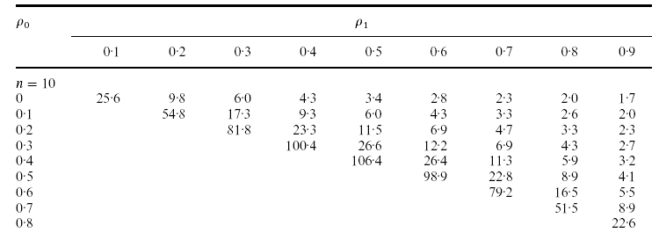
Sample from Table II of Walter et al 1998
ρ₁ = the ICC that you expect
ρ₀ = the lowest ICC that you would accept
n = the number of raters

Slide 30
Application to fBIRN Phase 1 fMRI Data
SITES ARE RATERS !!!!!
8 sites included:
BWHM
D15T
IOWA
MAGH
MINN
NMEX
STAN
UCSD

Slide 31
Looked at ICC(AGREEMENT) in the Phase I Study – Sensorimotor Paradigm
4 runs of the SM
Question:
Is reliability greater for measures of signal only or for measures of SNR or CNR?
Signal Only: measured percent change.
CNR: proportion of total variance accounted for by the reference vector.

Slide 32



3 ROIs Used for Phase I SM Data
BA04
BA41
BA17

Slide 33
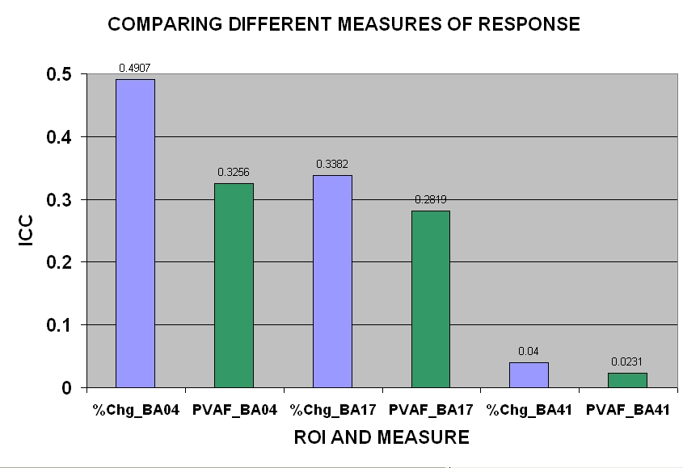
Signal vs CNR across Brodmann Areas

Slide 34
In summary:
Reliability is highest in motor cortex, very low in auditory cortex
Reliability is highest when using a measure of signal only (percent change), not SNR or CNR (proportion of variance accounted for)

Slide 35
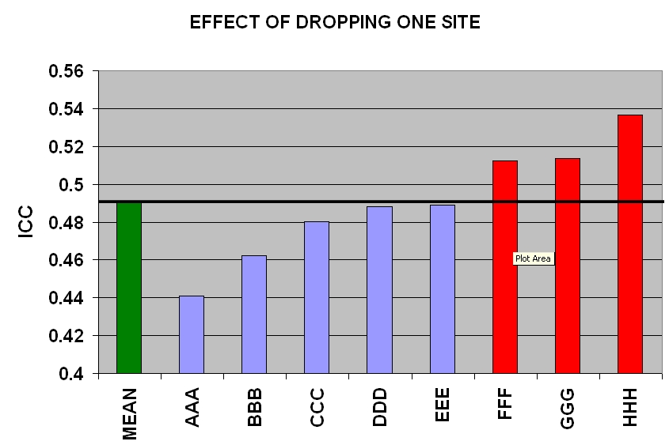
EFFECT OF DROPING ONE SITE ICC(AGREEMENT) %CHANGE BA04
IF WE DROPPED ALL 3, ICC = 0.64
ICC FOR BA04 – PERCENT CHANGE

Slide 36
Interesting Questions Yet To Be Addressed
What is the role of increasing the number of runs on reliablity?
could be very substantial
What about reliability of ICA vs GLM?
Might ICA have elevated reliability?
THE END

Slide 37
What is the difference between ICC(2,1) and ICC(3,1)?
The distinction between these two ICCs is often thought of in terms of the design of the ANOVA that each is based on.
ICC(2,1) is based on a two-way random effects model, with raters and patients considered as random variables. In other words:
a finite set of raters are drawn from a larger (infinite) population of potential raters. This finite set of raters rate:
a finite set of patients drawn from a potentially infinite set of such patients
As such, ICC(2,1) would apply to all such raters rating all such patients.

Slide 38
What is the difference between ICC(2,1) and ICC(3,1)?
ICC(3,1) is based on a Mixed Model ANOVA model, with raters treated as a fixed effect and patients considered as a random effect. In other words:
a finite set of raters are the only raters you are interested in evaluating. This is reasonable if you just want the ICC of certain raters (scanners) in your study and do not need to generalize beyond them. These raters rate:
a finite set of patients drawn from a potentially infinite set of such patients
As such, ICC(3,1) would assess the reliability of just these raters, as if they were rating all such patients.

Slide 39
What is the difference between ICC(2,1) and ICC(3,1)? First, we must discuss CONSISTENCY vs AGREEMENT
Shrout and Fleiss (1979) make a distinction between an ICC that measures CONSISTENCY and an ICC that measures AGREEMENT.
An ICC that measures consistency emphasizes the association between raters scores
Not typically what one wants for an interrater reliability study.
ICC(3,1), as presented by S&F, is an ICC(CONSISTENCY)
An ICCs that measures agreement emphasizes the INTERCHANGEABILITY of the raters
This is typically what one wants when one measures interrater reliability.
Only ICC(2,1) in the S&F nomenclature is an ICC(AGREEMENT).

